Slide 1
brng_stoc_snn.py
김문기, 노윤지

Slide 2
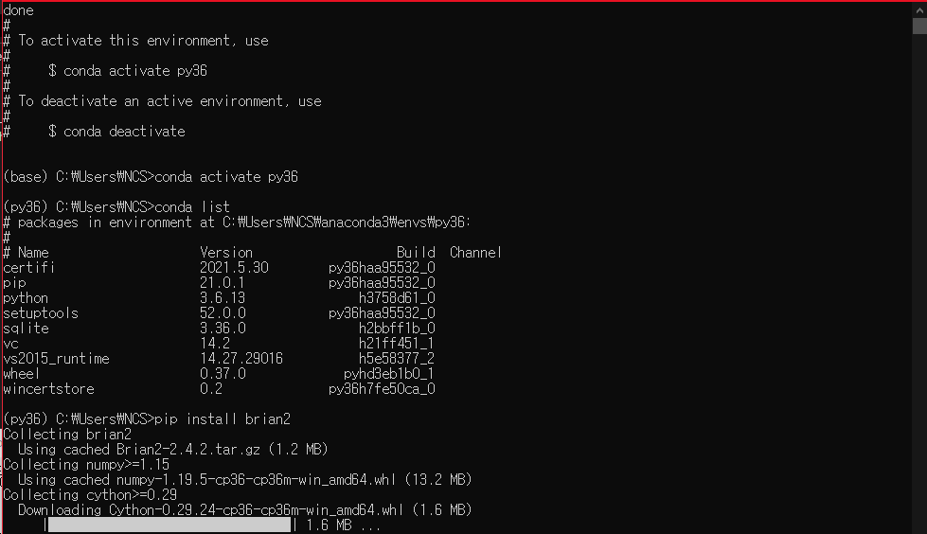
Python 3.6 in anaconda venv

Slide 3
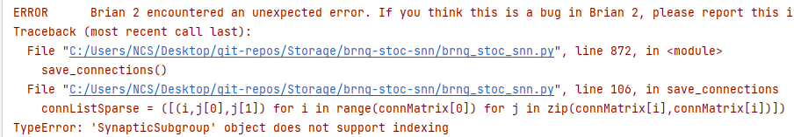
save_connections(), SynapticSubgroup
- test_mode = False
- test_set = True

Slide 4
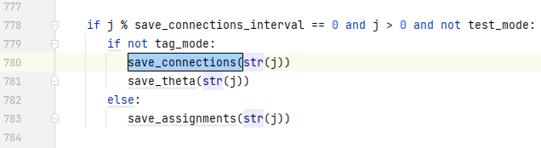

save_connections(), SynapticSubgroup

Slide 5
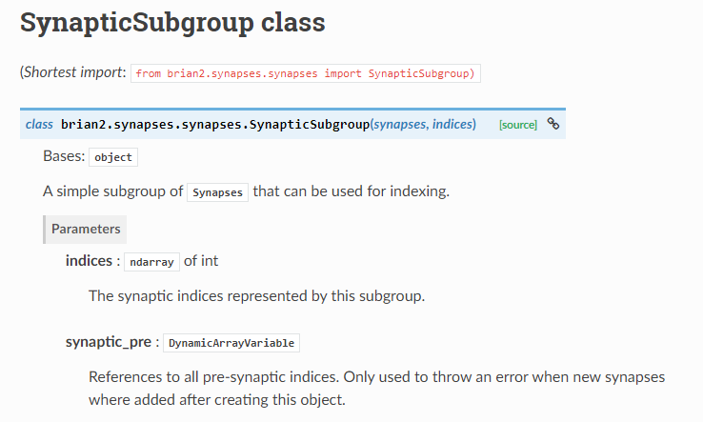
SynapticSubgroup

Slide 6
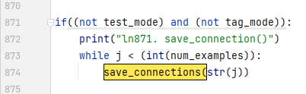

Fix arguments

Slide 7
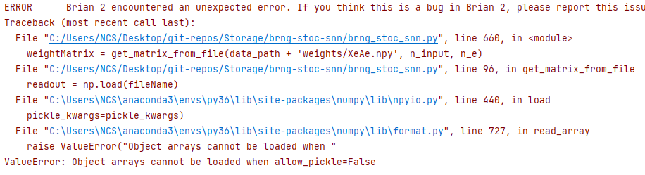
test_mode = True

Slide 8
